Slide 1

Project Management
Crime Rate Analysis in Toronto, Canada
Group #3 – DAB301-23F-001

Slide 2




Project Management
Group #3 – Team members
Srilakshmi Gummadidala
Vinod Soloman Santhakumar
Tehsin Shaikh
Yen Nga Le
Project Management - Crime Rate Analysis in Toronto, Canada

Slide 3

Project Overview
Crime, defined as the breach of established laws by individuals or groups, is a pervasive social issue with profound consequences for individuals, families, and communities. Addressing this challenge necessitates a holistic approach encompassing prevention, intervention, and victim support. This research delves into crime prevention strategies, aiming to comprehend crime patterns for the development of effective strategies in ensuring public safety, mitigating victimization, and enhancing community well-being.
Implementation of a comprehensive crime analytics system to identify patterns, recommend prevention strategies, and enhance public safety in the city of Toronto.
Project Management - Crime Rate Analysis in Toronto, Canada

Slide 4
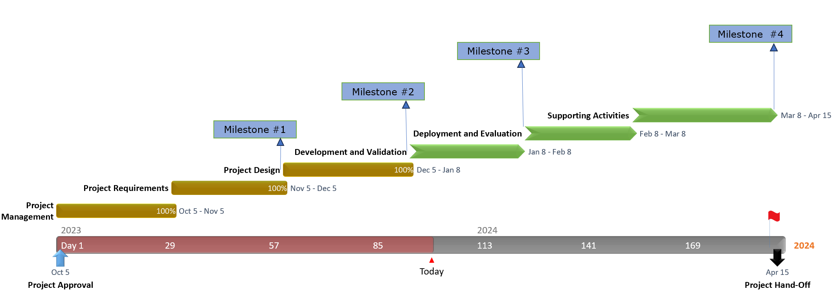
Activities Timeline
Project Management - Crime Rate Analysis in Toronto, Canada

Slide 5

Process Stages
- Define scope
- Develop Project Schedule
- Develop Risk Plan
- Develop Financial Plan
- Develop Project Management Plan
MONITORING
PLANNING
CLOSURE
EXECUTION
INITIATION
CONTROLLING
- Develop Project Case & Project Charter
- Develop Preliminary Project Scope Statement
- Acquire Resources
- Manage Quality & Communication
- Implement Risk Responses
Project Management - Crime Rate Analysis in Toronto, Canada

Slide 6
Initiation
GOAL
OBJECTIVES
Identification of initial project requirements
Solidification of project scope
Investigation of possible solution
Construct a comprehensive and well-organized dataset for in-depth analysis.
Implement cutting-edge analytical techniques
Provide user-friendly and interactive reporting tools
RECOGNITIONS
DELIVERABLES
Sponsor
Project Manager
Stakeholders
Business Case
Business Charter
Stakeholder Register
Project Management - Crime Rate Analysis in Toronto, Canada
Notes:
The goal of Initiating phase is identification of initial project requirements, solidification of project scope and investigation of possible solution.

Slide 7
Planning
Deliverables
Project Scope Statement
Work Breakdown Structure (WBS)
Project Schedule
Resource Plan
Risk Management Plan
Communication Plan
Quality Management Plan
Cost Estimate
Stakeholder Management Plan
Change Management Plan
Procurement Plan
Approval Sign-offs
Approves the project to begin work & Concludes with the project kickoff meeting
Provides the baseline to execute and manage the project
Defines the detailed project schedule, budget, and resource assignments
Delivers a project plan
Project Management - Crime Rate Analysis in Toronto, Canada

Slide 8
Execution
Planning of Execution
Resource Allocation
Quality Control
PHASE 1
PHASE 3
PHASE 5
PHASE 2
PHASE 4
PHASE 6
Organization of Execution
Evaluation of Execution
Implementation
Deliverables: Change logs, Change requests, Resource Assignments, Communication Records, Procurement Documents, RACI matrix, Cost & Budget…
Project Management - Crime Rate Analysis in Toronto, Canada

Slide 9
Monitoring & Controlling
LESSON LEARNED DOCUMENTS
ISSUE LOGS
Monitoring
Controlling
Progress monitoring
Quality monitoring
Risk monitoring
Cost monitoring
Stakeholder Engagement monitoring
Communication monitoring
Control Scope
Control Schedule
Cost control
Quality control
Resources control
Procurement control
MEETING DOCUMENTS
STATUS REPORTS
Deliverables
Project Management - Crime Rate Analysis in Toronto, Canada

Slide 10
Closing Stage
FINAL TEAM MEETING
Confirm work is done as per the requirements
Complete procurement closure
Gain formal acceptance
Complete final performance reporting
Index and archive records
Update lessons learned
LESSONS LEARNED REGISTER
Deliverables
PROJECT CLOSURE REPORT
Project Management - Crime Rate Analysis in Toronto, Canada

Slide 11
Thank You
Group #3 – DAB301-23F-001
Project Management - Crime Rate Analysis in Toronto, Canada

